Slide 1
Clustering basics (Partitioned, Hierarchical and Density based)

Slide 2
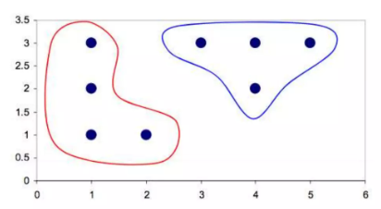
02 / 29
What is Clustering?
Grouping of records ,observations or cases into classes of similar objects.
A cluster is a collection of records,
Similar to one another
Dissimilar to records in other clusters

Slide 3
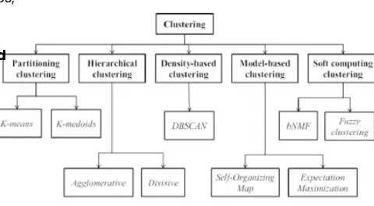
INTRODUCTION
03 / 29
Introduction to Clustering
Clustering is a machine learning technique used to group similar data points together based on their characteristics, making it easier to analyze and understand large datasets. It’s an unsupervised learning method where algorithms identify natural groupings without predefined labels. The main types of clustering include:-
Partitional Clustering
Hierarchical Clustering
Density Based Clustering
Model-based Clustering
Soft computing clustering

Slide 4
INTRODUCTION
04 / 29
Difference between Clustering and Classification
There is no target variable for clustering
Clustering does not try to classify or predict the values of a target variable.
Instead, clustering algorithms seek to segment the entire data set into relatively homogeneous subgroups or clusters,
Where the similarity of the records within the cluster is maximized, and
Similarity to records outside this cluster is minimized.

Slide 5
INTRODUCTION
05 / 29
Goal of Clustering
Identification of groups f records such that similarity within a group is very high while the similarity to records in other groups is very low.
group data points that are close (or similar) to each other
identify such groupings (or clusters) in an unsupervised manner
Unsupervised: no information is provided to the algorithm on which data points belong to which clusters
In other words,
Clustering algorithm seeks to construct clusters of records such that the between-cluster variation(BCV) is large compared to the within-cluster variation(WCV)

Slide 6
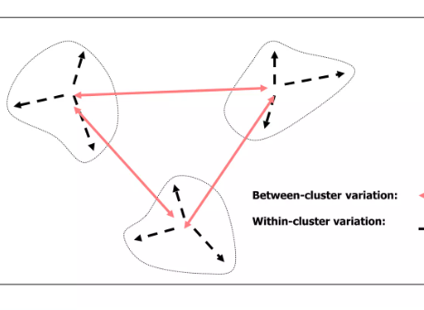
INTRODUCTION
06 / 29
Goal of Clustering
(Intra-cluster distance) the sum of distances between objects in the same cluster are minimized
(Inter-cluster distance) while the distances between different clusters are maximized
between-cluster variation(BCV) is large compared to the within-cluster variation(WCV)

Slide 7
INTRODUCTION
07 / 29
Clustering
Clustering techniques apply when there is no class to be predicted
As we’ve seen clusters can be:
disjoint vs. overlapping
deterministic vs. probabilistic
flat vs. hierarchical
k-means Algorithm
k-means clusters are disjoint, deterministic, and flat

Slide 8
INTRODUCTION
08 / 29
Issues Related to Clustering
How to measure similarity
Euclidian Distance
City-block Distance
Minkowski Distance
How to recode categorical variables?
How to standardize or normalize numerical variables?
Min-Max Normalization
Z-score standardization ( m, S )
How many clusters we expect to uncover?

Slide 9
PARTITIONAL CLUSTERING
09 / 29
Type of Clustering
Partitional clustering: Partitional algorithms determine all clusters at once. They include:
K-Means Clustering
Fuzzy c-means clustering
QT clustering
Hierarchical Clustering:
Agglomerative (“bottom-up”): Agglomerative algorithms begin with each element as a separate cluster and merge them into successively larger clusters.
Divisive (“top-down”): Divisive algorithms begin with the whole set and proceed to divide it into successively smaller clusters.

Slide 10
PARTITIONAL CLUSTERING
10 / 29
k-Means Clustering
Input: n objects (or points) and a number k
Algorithm
1) Randomly assign K records to be the initial cluster center locations
2) Assign each object to the group that has the closest centroid
3) When all objects have been assigned, recalculate the positions of the K centroids
4) Repeat steps 2 to 3 until convergence or termination

Slide 11
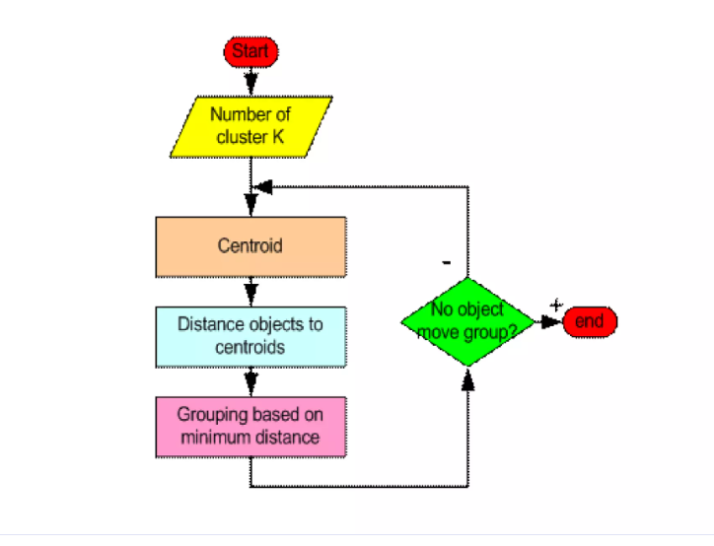
PARTITIONAL CLUSTERING
11 / 29
K-Mean Clustering

Slide 12
PARTITIONAL CLUSTERING
12 / 29
Termination Conditions
The algorithm terminates when the centroids no longer change.
The SSE(sum of squared errors) value is less than some small threshold value α
SSE = Σ_{i=1}^{k} Σ_{p∈C_{i}} d(p, m_{i})²
Where p ∈ C_{i} represents each data point in cluster i and m_{i} represent the centroid of cluster i.

Slide 13
K-Modes Clustering Algorithm
Clustering Categorical Data

Slide 14
Why K-Modes?
K-means works only on numeric data (uses mean and Euclidean distance)
Categorical data such as colour, city or job has no meaningful mean
K-modes replaces the mean with the MODE
It replaces Euclidean distance with a simple matching count
Same idea as K-means: group similar records into k clusters

Slide 15
Key Concepts
Mode: the most frequent category of each attribute in a cluster
Dissimilarity: number of attributes where two records differ
Example: (Red, Small, Round) vs (Red, Large, Round) gives distance = 1
Cost: total dissimilarity between records and their cluster modes
Goal: minimise the total cost

Slide 16
Algorithm Steps
1. Choose the number of clusters k
2. Select k initial modes (random records)
3. Assign each record to the nearest mode (fewest mismatches)
4. Recompute the mode of every cluster
5. Repeat steps 3 and 4 until no record changes cluster

Slide 17
Problem: Grouping Students (k = 2)
Student | Sport | Music | Weekend
S1 | Cricket | Rock | Outdoor
S2 | Cricket | Rock | Outdoor
S3 | Chess | Classical | Indoor
S4 | Chess | Classical | Indoor
S5 | Cricket | Classical | Outdoor
S6 | Chess | Rock | Indoor
Initial modes: A = S1 (Cricket, Rock, Outdoor), B = S3 (Chess, Classical, Indoor)

Slide 18
Solution
Distances: S5 to A = 1, to B = 2, so S5 joins A
Distances: S6 to A = 2, to B = 1, so S6 joins B
Cluster A = {S1, S2, S5}; Cluster B = {S3, S4, S6}
New modes: A = (Cricket, Rock, Outdoor); B = (Chess, Classical, Indoor)
Modes unchanged, so the algorithm has converged
Total cost = 2

Slide 19
Advantages, Limitations and Uses
Advantages: fast, simple, easy to interpret
Limitations: sensitive to initial modes, k must be given, ties in modes
Run several times and keep the lowest cost
Mixed data: use K-prototypes
Uses: customer segmentation, survey analysis, medical records

Slide 20
HIERARCHICAL CLUSTERING
13 / 29
Hierarchical clustering
There are two styles of hierarchical clustering algorithms to build a tree from the input set S:
Agglomerative (bottom-up):
Beginning with singletons (sets with 1 element)
Merging them until S is achieved as the root.
In each steps , the two closest clusters are aggregates into a new combined cluster
In this way, number of clusters in the data set is reduced at each step
Eventually, all records/elements are combined into a single huge cluster
It is the most common approach.
Divisive (top-down):
All records are combined in to a one big cluster
Then the most dissimilar records being split off recursively partitioning S until singleton sets are reached.
Does not require the number of clusters k in advance

Slide 21
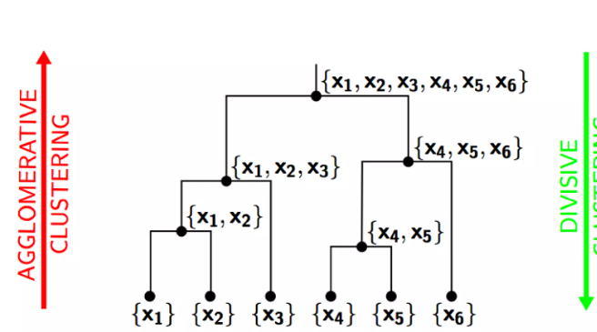
HIERARCHICAL CLUSTERING
14 / 29
Hierarchical Clustering: Two Types
Two types of hierarchical clustering algorithms :
Agglomerative : “bottom-up”
Divisive : “top-down”

Slide 22
HIERARCHICAL CLUSTERING
15 / 29
Classification of AHC
We can distinguish AHC algorithms according to the type of distance measures used. There are two approaches :
Graph methods :
Single link method
Complete link method
Group average method (UPGMA)
Weighted group average method (WPGMA)
Geometric :
Ward’s method
Centroid method
Median method

Slide 23
HIERARCHICAL CLUSTERING
16 / 29
Agglomerative Clustering Algorithm
More popular hierarchical clustering technique
Basic algorithm is straightforward
1. Compute the distance matrix
2. Let each data point be a cluster
3. Repeat
4. Merge the two closest clusters
5. Update the distance matrix
6. Until only a single cluster remains
Key operation is the computation of the distance between two clusters
Different approaches to defining the distance between clusters distinguish the different algorithms

Slide 24
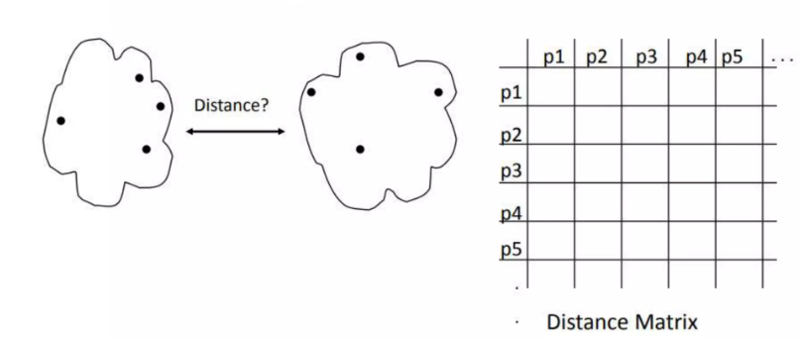
HIERARCHICAL CLUSTERING
17 / 29
How to Define Inter-Cluster Distance
Single link method (Min)
Complete link method (Max)
Average link (group Average)
Centroid method (Distance between centriods)

Slide 25
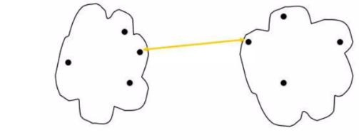
HIERARCHICAL CLUSTERING
18 / 29
Single link method (Min)
The distance between two clusters is represented by the distance of the closest pair of data objects belonging to different clusters.
Determined by one pair of points, i.e., by one link in the proximity graph
d_{min}(C_{i}, C_{j}) = min_{p∈C_{i}, q∈C_{j}} d(p, q)

Slide 26
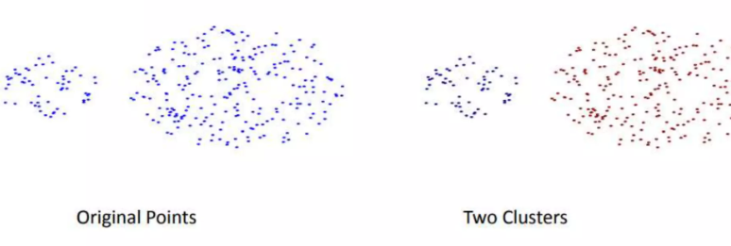
HIERARCHICAL CLUSTERING
19 / 29
Single link method (Min)
Can handle non-elliptical shapes

Slide 27
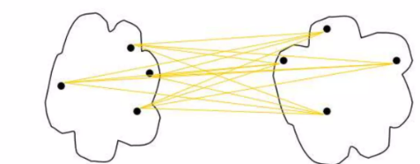
HIERARCHICAL CLUSTERING
20 / 29
Average link (Group Average)
The distance between two clusters is represented by the average distance of all pairs of data objects belonging to different clusters
Determined by all pairs of points in the two clusters
d_{avg}(C_{i}, C_{j}) = avg_{p∈C_{i}, q∈C_{j}} d(p, q)

Slide 28
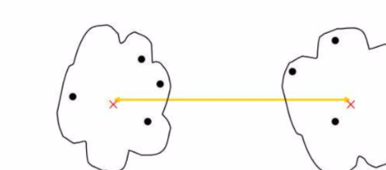
HIERARCHICAL CLUSTERING
21 / 29
Centroid method (Distance between centroids)
The distance between two clusters is represented by the distance between the centers of the clusters
Determined by cluster centroids
d_{mean}(C_{i}, C_{j}) = d(m_{i}, m_{j})

Slide 29
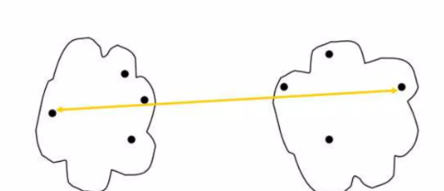
HIERARCHICAL CLUSTERING
22 / 29
Complete link method (Max)
The distance between two clusters is represented by the distance of the farthest pair of data objects belonging to different clusters
d_{max}(C_{i}, C_{j}) = max_{p∈C_{i}, q∈C_{j}} d(p, q)

Slide 30
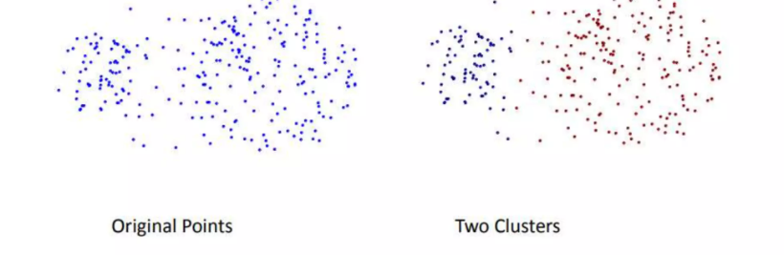
HIERARCHICAL CLUSTERING
23 / 29
Complete link method (Max)
Less susceptible to noise and outliers

Slide 31
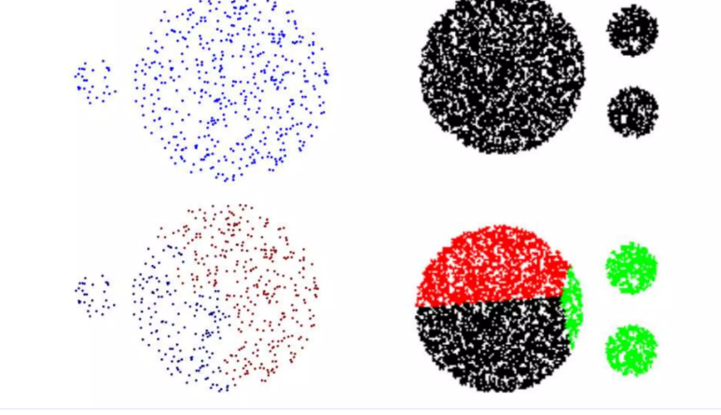
HIERARCHICAL CLUSTERING
24 / 29
Complete link method (Max)
Tends to break large clusters

Slide 32
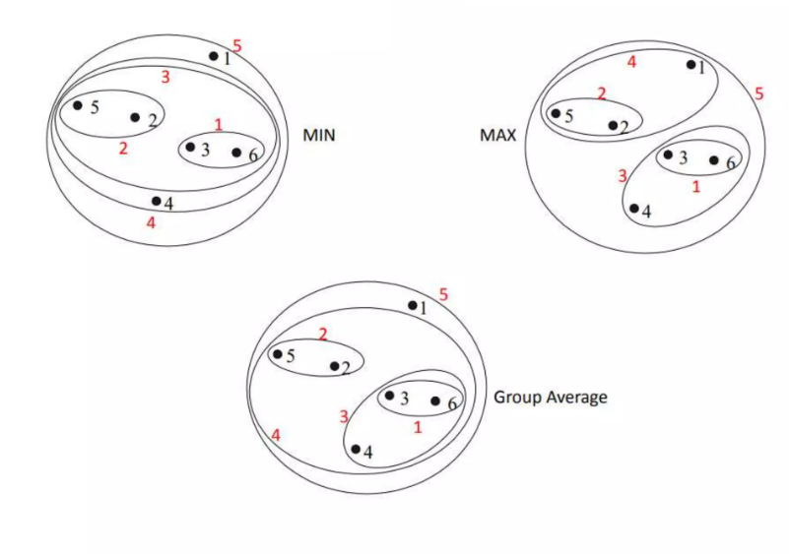
HIERARCHICAL CLUSTERING
25 / 29
Comparison

Slide 33
The Problem
2 / 7
Five points on a number line: A = 1, B = 2, C = 6, D = 7, E = 15
A=1
B=2
C=6
D=7
E=15
 | A | B | C | D | E
A | 0 | 1 | 5 | 6 | 14
B | 1 | 0 | 4 | 5 | 13
C | 5 | 4 | 0 | 1 | 9
D | 6 | 5 | 1 | 0 | 8
E | 14 | 13 | 9 | 8 | 0
Distance matrix
Distance = difference of values
Example: A to C = 6 - 1 = 5
Goal: merge the closest clusters, again and again

Slide 34
Steps 1 and 2: Same for Every Method
3 / 7
Smallest distance in the matrix is 1, and it appears twice: A-B and C-D
Merge both, giving {A,B}, {C,D} and E
Merge height = 1 for both merges
Now clusters have 2 points, so we need a rule for the distance between clusters
Each method uses a different rule - that is the only difference between them
{A,B}
{C,D}
{E}

Slide 35
Single Link and Complete Link
4 / 7
Single link (Min): closest pair
Complete link (Max): farthest pair
{A,B} to {C,D}: pairs 5, 6, 4, 5 -> min = 4
{C,D} to E: 9, 8 -> min = 8
{A,B} to E: 14, 13 -> min = 13
Merge {A,B} + {C,D} at height 4
Then {A,B,C,D} to E = 8
{A,B} to {C,D}: pairs 5, 6, 4, 5 -> max = 6
{C,D} to E: 9, 8 -> max = 9
{A,B} to E: 14, 13 -> max = 14
Merge {A,B} + {C,D} at height 6
Then {A,B,C,D} to E = 14
Heights: 1, 1, 4, 8
Heights: 1, 1, 6, 14

Slide 36
Average Link and Centroid Link
5 / 7
Average link: mean of all pairs
Centroid link: distance between means
{A,B} to {C,D}: (5+6+4+5) / 4 = 5
{C,D} to E: (9+8) / 2 = 8.5
{A,B} to E: (14+13) / 2 = 13.5
Merge {A,B} + {C,D} at height 5
Then {A,B,C,D} to E = (14+13+9+8) / 4 = 11
Centers: {A,B} = 1.5, {C,D} = 6.5, E = 15
{A,B} to {C,D}: 6.5 - 1.5 = 5
{C,D} to E: 15 - 6.5 = 8.5
Merge at height 5; new center = 4
Then {A,B,C,D} to E = 15 - 4 = 11
Heights: 1, 1, 5, 11
Heights: 1, 1, 5, 11

Slide 37
Comparing the Four Methods
6 / 7
Method | Distance rule | Merge heights | Tends to
Single | closest pair | 1, 1, 4, 8 | chain clusters, sensitive to noise
Complete | farthest pair | 1, 1, 6, 14 | compact clusters, breaks large ones
Average | mean of all pairs | 1, 1, 5, 11 | sit between single and complete
Centroid | distance between means | 1, 1, 5, 11 | be intuitive, heights can dip
Same first two merges (height 1) in every method; the methods differ from step 3 on.

Slide 38
Reading the Result
7 / 7
Dendrogram idea
Final clusters
Merge heights are the heights in the dendrogram
In all four methods E joins last, after a big jump
That jump means E is far from everything else
Cut just before the last merge to get 2 clusters
{A, B, C, D}
{E}
E is the outlier
Linkage changes the heights, and on messier data it can change which points group together

Slide 39
DENSITY-BASED CLUSTERING
26 / 29
DBSACN
DBSCAN is a density-based algorithm
DBScan stands for Density-Based Spatial Clustering of Applications with Noise
Density-based Clustering locates regions of high density that are separated from one another by regions of low density
Density = number of points within a specified radius (Eps)

Slide 40
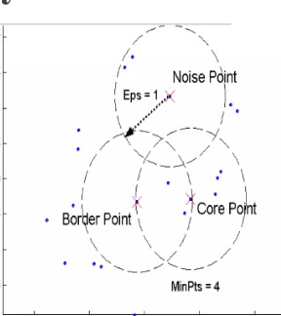
DENSITY-BASED CLUSTERING
27 / 29
Concepts: Preliminary
A point is a core point if it has more than a specified number of points (MinPts) within Eps
These are points that are at the interior of a cluster
A border point has fewer than MinPts within Eps, but is in the neighborhood of a core point
A noise point is any point that is not a core point or a border point

Slide 41
DENSITY-BASED CLUSTERING
28 / 29
Parameter Estimation
parameters must be specified by the user: ε = physical distance(radius), minPts = desired minimum cluster size
minPts
derived from the number of dimensions D in the data set, as minPts ≥ D + 1
minPts = 1 does not make sense, as then every point on its own will already be a cluster
minPts must be chosen at least 3. larger is better.
larger the data set, the larger the value of minPts should be chosen.
ε
value can be chosen by using a k-distance graph.
if ε is chosen much too small, a large part of the data will not be clustered.
if too high value, majority of objects will be in the same cluster
in general, small values of ε are preferable.

Slide 42
Quick Comparison of the Three Approaches
29 / 29
Partitional (k-means)
Hierarchical
Density-based (DBSCAN)
Needs k in advance.
Fast and scalable on large data.
Best for compact, roughly round clusters; sensitive to outliers and starting centroids.
No k needed up front; cut the dendrogram later.
Linkage choice (single, complete, average) changes the result.
Memory grows as O(n^2), so best for small to medium data.
Finds arbitrary shapes and flags noise.
Needs Eps and MinPts instead of k.
Struggles when clusters have very different densities.

